Slide 1
Data Science Engineering Methods and Tools Lecture 7
Northeastern University
College of Engineering
Multidisciplinary Graduate Engineering Department
INFO 6105 – Fall 2025
Instructor: Abdolreza Mosaddegh

Slide 2
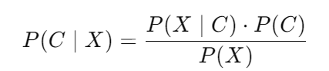
Naive Bayes classifiers
The Naïve Bayes classifier is a supervised machine learning algorithm
A family of linear probabilistic classifiers
Assumes that the features are conditionally independent, given the target value. Despite this unrealistic assumption (Naïve) it works well in many applications
Bayes Rule: The conditional probability can be decomposed as:
Naïve Bayes classifier predicts the most probable class (between all possible classes) by appearance of features (x); this is known as the maximum a posterior (MAP)
Probability of class C before observing feature (Prior)
Probability of class C after observing feature value X (Posterior) →

Slide 3
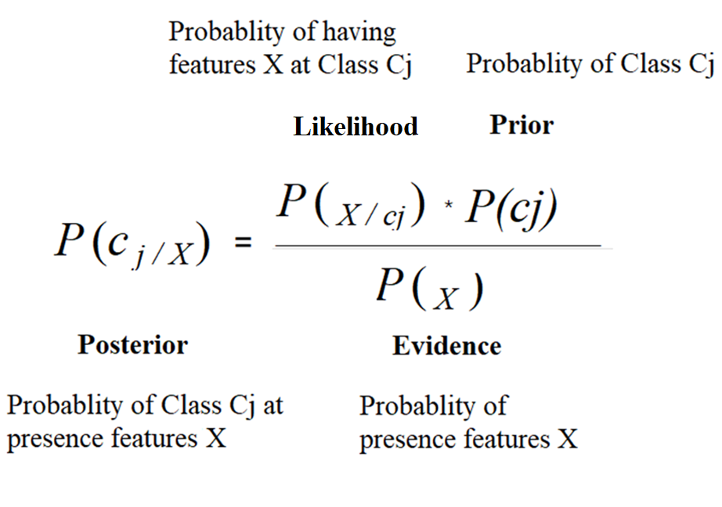
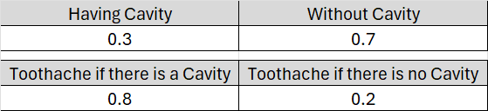
Bayes Rule
1 .P(x,y) = probability of happening both x and y → P(x,y) = P(y,x) [Symmetric]
Independent x, y: (if there is no relationship between class and features – modeling is not possible)
p(x, y) = p(x)*p(y)
Dependent x, y: (if there is a relationship between class and features)
2. p(x, y) = p(x|y)*p(y) conditional probability
3. P(y, x) = p(y|x)*p(x)
1,2,3 → p(y|x)*p(x) = p(x|y)*p(y) → p(y|x) = p(x|y)*p(y)/ p(x)

Slide 4
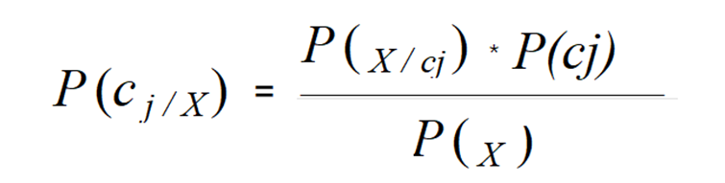
Naïve Bayes - Example
Based on Domain Knowledge (Medicine):
Probability of any patient having meningitis is 1/50,000 (Prior)
Meningitis causes stiff neck 50% of the time (likelihood)
Probability of having stiff neck is 1/20 (evidence)
Observed feature: A patient has a stiff neck (presence of a feature)
Classification Problem: What is the probability that the patient has meningitis ?
There are two classes meningitis (M) and not meningitis (~M). The most probable class having stiff neck can be calculated using the Bayes Rule:
$P(M|S)=\frac{P(S|M)P(M)}{P(S)}=\frac{0.5 × 1/50000}{1/20}=0.0002$ → P(~M|S) = 0.9998
The most probable class having stiff neck is No-Meningitis (maximum posterior)

Slide 5
Naive Bayes Method
If there are several features, then the most probable class can be defined as:
P(x1,x2,…,xn) is the same for all classes
Independence assumption: attribute values are conditionally independent given the target value:
P(x1,x2,…,xn | Cj) = P(x1| Cj) * P(x2| Cj) * … * P(xn| Cj) → CMAP= ArgMax [P(Cj) * π P(xi|Cj)]
P(c_{j}): Can be estimated from domain knowledge or from the frequency of classes in the training dataset
P(xi| Cj) : Can be estimated from domain knowledge or from the frequency of each feature value in each class in training dataset

Slide 6
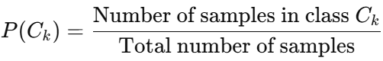
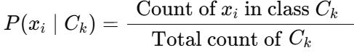
Naive Bayes – Training
The objective of training is to find the best fit model for the training data
During training parameters of model are calculated using the training data :
Compute the probability of each class (Prior) :
Compute the probability of each feature value in each class (Likelihoods):
The computed parameters are stored to be used during inference phase

Slide 7
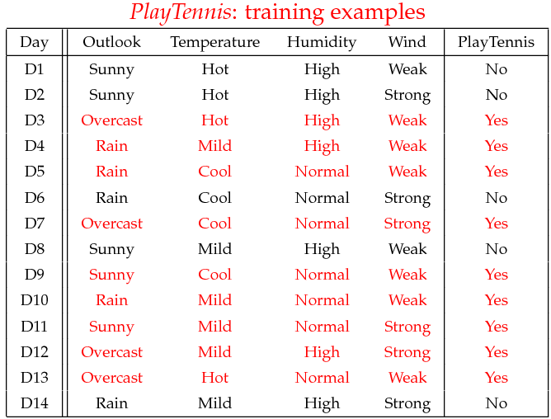
Training - Example
P(c1) = P(Play Tennis= yes) = 9/14 P(c2)=P(Play Tennis= No) = 5/14
Classification Problem: Predict two classes of Play Tennis (Yes) or Not (NO) based on weather conditions (features)
(14)
Step 1: Calculation of Prior

Slide 8
Training - Example
Step 2: Calculation of Likelihoods
P(x₁|c₁)
P(x₁|c₂)
 | OUTLOOK
 | Playing Tennis = Yes | Playing Tennis = No
Sunny | 2/9 | 3/5
Overcast | 4/9 | 0/5
Rainy | 3/9 | 2/5
Total | 9/9 | 5/5

Slide 9
Training - Example
Step 2: Calculation of Likelihoods
P(x₂|c₁)
P(x₂|c₂)
 | TEMPERATURE
 | Playing Tennis = Yes | Playing Tennis = No
Hot | 2/9 | 2/5
Mild | 4/9 | 2/5
Cool | 3/9 | 1/5
Total | 9/9 | 5/5

Slide 10
Training - Example
Step 2: Calculation of Likelihoods
P(x₃|c₁)
P(x₃|c₂)
 | HUMIDITY
 | Playing Tennis = Yes | Playing Tennis = No
High | 3/9 | 4/5
Low | 6/9 | 1/5
Total | 9/9 | 5/5

Slide 11
Training - Example
Step 2: Calculation of Likelihoods
P(x₄|c₁)
P(x₄|c₂)
 | WIND
 | Playing Tennis = Yes | Playing Tennis = No
Strong | 3/9 | 3/5
Weak | 6/9 | 2/5
Total | 9/9 | 5/5

Slide 12
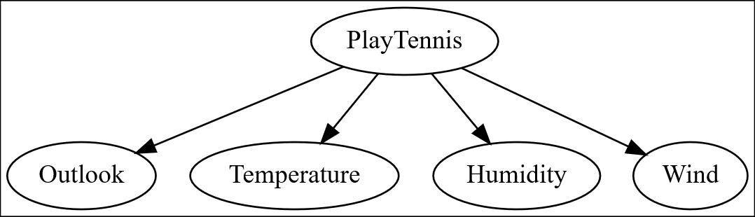
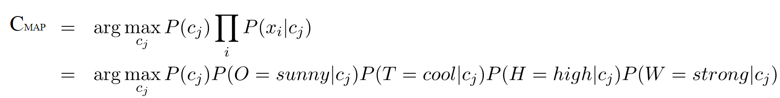
Inference - Example
Predict (Yes, No) for the following datapoint x (unseen data):
x = (Outlook = sunny, temperature = cool, Humidity = High, Wind = Strong)
Find most probable class by having features x:

Slide 13
Inference - Example
Probabilities calculated during training phase for Outlook = sunny, temperature = cool, Humidity = High, Wind = Strong:
P(Outlook = sunny | play = no) = 3/5
P(Temperature = cool | play = no) = 1/5
P(Humidity = high | play = no) = 4/5
P(Wind = strong | play = no) = 3/5
P(C2) = P(Play Tennis= no) = 5/14
C1 | X : P(Yes)*[P(Sunny|Yes)*P(Cool|Yes)*P(High|Yes) *P(Strong|Yes)] = 9/14 * 2/9 *3/9 * 3/9 * 3/9 = 0.0206
C2 | X : P(No) *[P(Sunny|No) *P(Cool|No) *P(High|No) *P(Strong|No)] = 5/14 * 3/5 * 1/5* 4/5 * 3/5 = 0.0053
CMAP = arg max class(C1 = 0.0206, C2= 0.0053) = C1 → Play Tennis = Yes
P(Outlook = sunny | play = yes) = 2/9
P(Temperature = cool | play = yes) = 3/9
P(Humidity = high | play = yes) = 3/9
P(Wind = strong | play = yes) = 3/9
P(C1) = P(Play Tennis = yes) = 9/14
These numbers are not probabilities

Slide 14
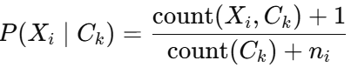
Zero Frequency - Categorical Data
Calculation of probabilities of each feature value in each class, P(xi| Ck), require large number of training data to cover all values
If there is no occurrences of a certain feature value in a class in the training data, P(xi| Ck) = 0, then the probability estimate will be zero (zero frequency):
Zero frequency can cause the entire product of probabilities in the Naive Bayes classifier to be zero which means there is zero chance for a class
In real-world data, not occurrence in training set does not mean impossible
Zero frequency can be solved by Laplace Smoothing which adds a small constant (e.g., 1) to the count of each value to avoid zero probabilities:
P(Ck) * π P(xi|Ck) = 0
ni​ → number of possible distinct values of feature $X_{i}$

Slide 15
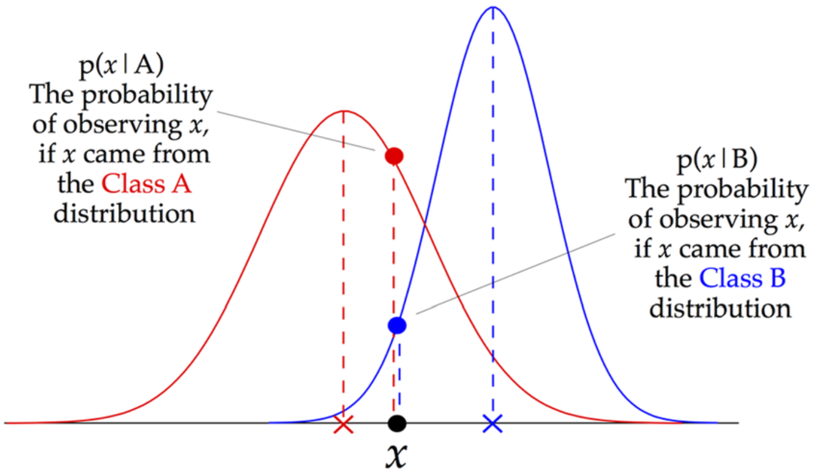
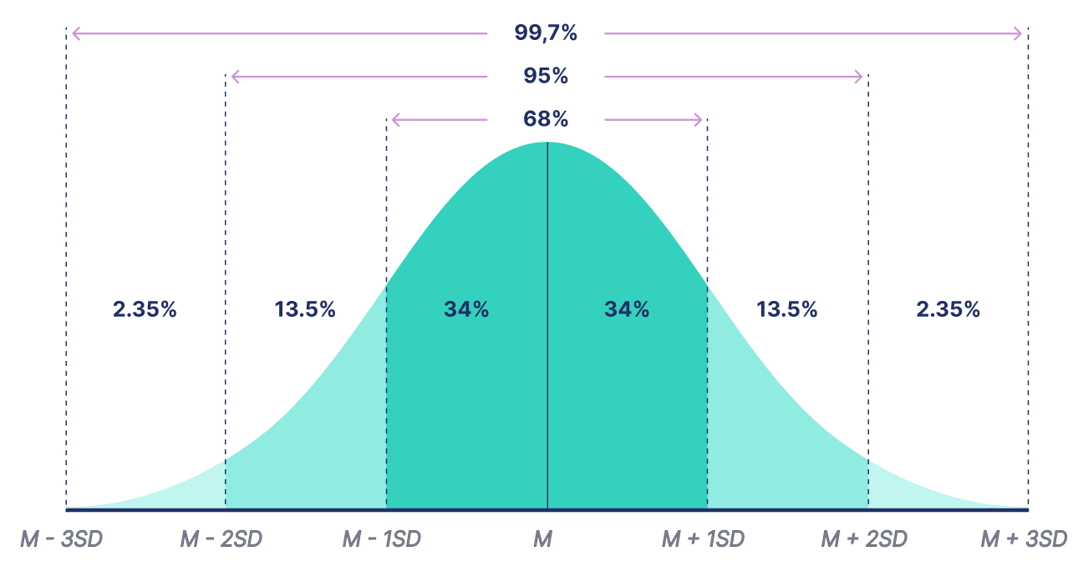
Naive Bayes for Continuous Features
In continuous features we usually can't find all possible values in training data
The Gaussian Naive Bayes algorithm can be used when the features are continuous. It assumes that the features follow a normal (Gaussian) distribution
It is possible to estimate normal distribution of a continuous feature using mean and standard deviation of samples
Probability of each feature value in each class, P(xi| Ck), can be estimated using the normal distribution of feature in that class

Slide 16
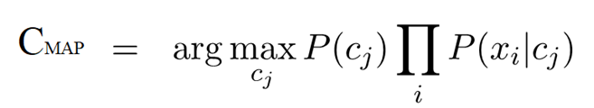
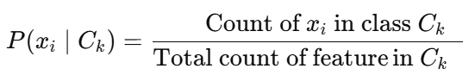
Data Preprocessing for Naïve Bayes
Naive Bayes does not require normalizing, even for continuous variables, as it works with probabilities and the scale of the features doesn't impact the model directly.
The model has an internal mechanism to handle missing values by ignoring the missing value during probability estimate calculations, therefore, imputation is not required.
Naive Bayes is robust to outliers in categorical features, since probabilities of an outlier within a class is very small and won’t have a strong effect on the final classification (but in continues features it has effect on distribution)

Slide 17
Advantages and Disadvantages of Naïve Bayes
Naïve Bayes is fast and thus can be used for making real time predictions
Naïve Bayes is suitable for high-dimensional datasets.
It handles categorical features effectively without need to convert them to numeric values
Naïve Bayes makes assumption of independent predictors. In real life it is often hard to get set of predictors which are completely independent
in some features, normal distribution assumption does not hold, leading to poor performance
If the training data is not representative of the population, the model may develop biases and produce inaccurate predictions.

Slide 18
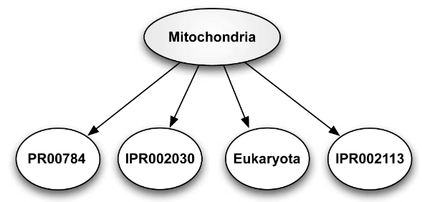
Applications of Naïve Bayes
Uncertainty is inherent in real-world situations. Bayesian models explicitly represent uncertainty through probabilities.
It prevents overconfidence and supports decision-making under uncertainty.
Can employ expert knowledge for estimation of probabilities
Due to interpretability and white-box nature of NB, it is often used in descriptive analysis in many applications:
Credit Risk Assessment: Based on a person's past financial behavior
Fraud Detection: Based on patterns of fraudulent activities
Disease Prediction: Based on symptoms of diseases
Genomic Data Analysis: Based on genetic markers
NLP: Word Sense Disambiguation (WSD) based on context
…

Slide 19
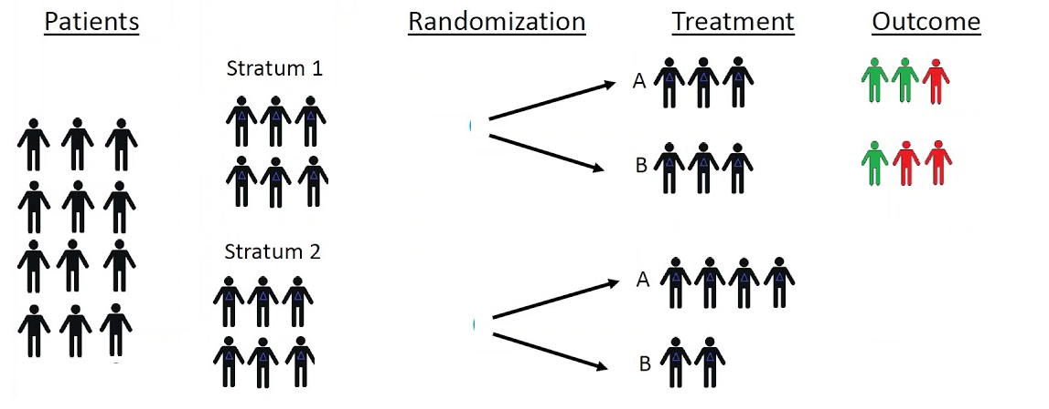
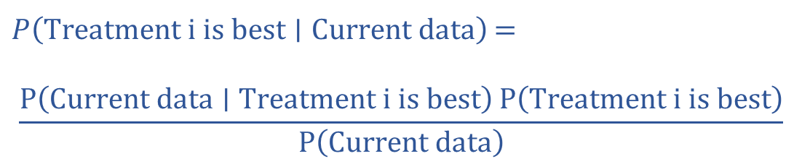
Example - Randomization Probabilities
In a traditional randomized medical trials, each patient has a fixed probability (e.g., 50%) of being assigned to each treatment.
In a Bayesian adaptive trial, the probability of assigning a new patient to each treatment changes over time, depending on efficacy of treatment
Ethical Aspect: more patients get better treatments based on new evidences.
Probability of assignment a patient to treatment i =
$P\left(\text{Treatment} i \text{is} \text{best}∣\text{Current} \text{data}\right)$ =
$$\frac{P\left(\text{Current} \text{data}∣\text{Treatment} i \text{is} \text{best}\right) P\left(\text{Treatment} i \text{is} \text{best}\right)}{P\left(\text{Current} \text{data}\right)}$$

Slide 20
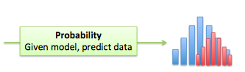
Probability
Probability is about predicting future events based on known models / rules
Probability is more aligned with deductive reasoning, since it use known principles and models to predict specific outcomes.
In inference phase of prediction models, the model is used to predict outcome (usage of probability)
Example: Flipping a coin, there is an equal chance of getting heads or tails. Based on this rule you can predict that there is a 50% chance of getting the head when you flip a coin

Slide 21
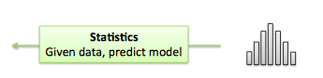
Statistics
Statistics tries to create model / extract patterns based on observations (past events)
Statistics is more aligned with inductive reasoning, since you induce models and patterns of general population from sample data
Use a sample of data for training a prediction model for the general population (usage of statistics)
Example: You flip a coin 10 times and you observe 6 heads and 4 tails. You induce a rule that there is a 60% chance of getting heads
In Bayesian models, statistics are used during the training to induce the probabilities based on relative frequencies. These probabilities are then used during inference to predict the likelihood of events

Slide 22
Markov chain
Markov Chain is a probabilistic model that represents a sequence of states
There are a finite number of states with the following properties:
The future state depends only on the present state, and not on any past states (Memoryless property).
2. Probabilities of transitions between states do not depend on time.
$$P\left({State at step t+1}_{}| States at 1, 2, …, t\right)=P\left(State at step t+1 ∣ State at step t\right)$$
Transition Probabilities
Transition Probabilities
Transition Probabilities
Transition Probabilities
State at
Step₁
State at Step₂
State at Step₃
State at Step₄
State at Step₅

Slide 23
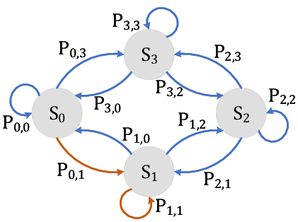
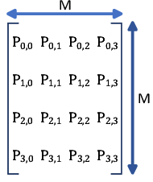
Transition Matrix
Contains all the transition probabilities of the Markov chain
$$P_{ij}=P\left(\text{st}\text{a}\text{te} \text{a}\text{t} \text{step} t+1=S_{j}∣\text{st}\text{a}\text{te} \text{a}\text{t} \text{step} t=S_{i}\right)$$
Each Markov Chain is a sequence of states over the transition graph (e.g., S3,S2,S2,S3)
Where Pij is the conditional probability of being in state Si at step t+1 given that the process was in state Sj at step t.
The transition matrix is square, since all states must be used both as rows and as columns.
The data of transition matrix is coming from training datasets or prior knowledge

Slide 24
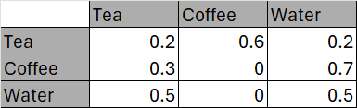
Transition Matrix - Example
All entries are between 0 and 1, because all entries represent probabilities.
The sum of the entries in any row must be 1, since the numbers in the row give the probability of changing from current state to future state
Transition Matrix
0.2
Future state (at step t+1)
Drink Tea
P(Tea_{t+1}|Coffe_{t})
current state (at step t)
0.3
0.5
0.6
0.2
Drink Coffee
Drink Water
0.2 | 0.6 | 0.2
0.3 | 0 | 0.7
0.5 | 0 | 0.5
0.7
A =
0.5

Slide 25
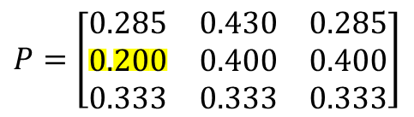
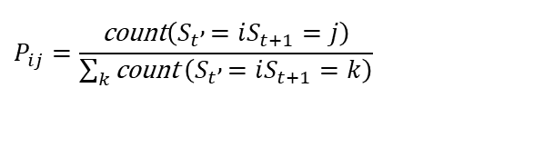
Markov Chain - Training
The training data set contains sequences of observed states over time:
Example: Seq1 = T,T,C,C,W,T,C Seq2= T,W,W,C
1- Count Transitions: Count how many times each transition occurs
2- Smoothing: Laplace can be used to smooth zero probabilities
3- Convert Counts to Probabilities: By normalizing
 | T | C | W
T | count(T→T)=1 | count(T→C)=2 | count(T→W)=1
C | count(C→T)=0 | count(C→C)=1 | count(C→W)=1
W | count(W→T)=1 | count(W→C)=1 | count(W→W)=1
 | T | C | W
T | count(T→T)=1+ 1 | count(T→C)=2+ 1 | count(T→W)=1+ 1
C | count(C→T)=0 + 1 | count(C→C)=1+ 1 | count(C→W)=1+ 1
W | count(W→T)=1+ 1 | count(W→C)=1+ 1 | count(W→W)=1+ 1
$$P_{ij}=\frac{\text{count}\left(S_{t} , =iS_{t+1}=j\right)}{\sum_{k}{\text{count}}\left(S_{t} , =iS_{t+1}=k\right)}$$
In real-world datasets there are more frequencies hence less probability for the zero count
 | T | C | W
T | P(T→T)=2/7 | P(T→C)=3/7 | P(T→W)=2/7
C | P(C→T)=1/5 | P(C→C)=2/5 | P(C→W)=2/5
W | P(W→T)=2/6 | P(W→C)=2/6 | P(W→W)=2/6
$$P=\left[\begin{matrix}0.285 & 0.430 & 0.285 \\ 0.200 & 0.400 & 0.400 \\ 0.333 & 0.333 & 0.333\end{matrix}\right]$$

Slide 26
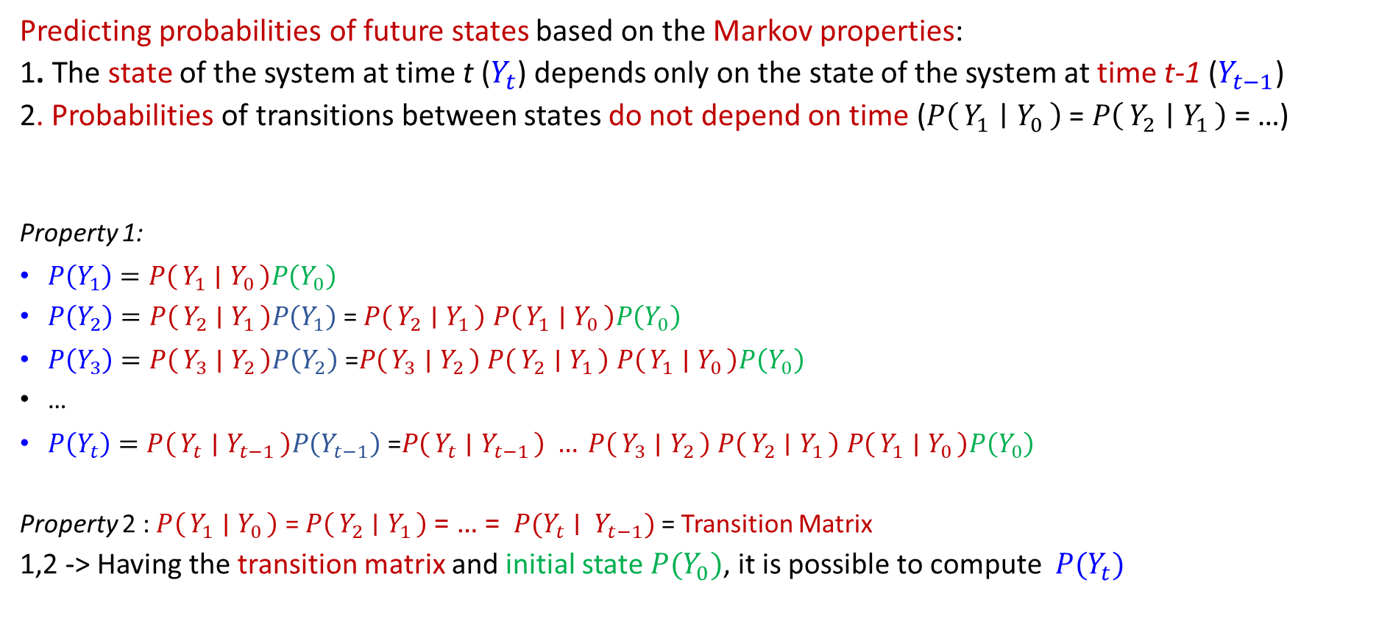
Markov Chain - Inference
Predicting probabilities of future states based on the Markov properties:
1. The state of the system at time t ($Y_{t}$) depends only on the state of the system at time t-1 ($Y_{t−1}$)
2. Probabilities of transitions between states do not depend on time ($P\left(Y_{1} ∣ Y_{0}\right)$ = $P\left(Y_{2} ∣ Y_{1}\right)$= …)
Property 1:
$P\left(Y_{1}\right)=P\left(Y_{1} ∣ Y_{0}\right)P\left(Y_{0}\right)$
$P\left(Y_{2}\right)=P\left(Y_{2} ∣ Y_{1}\right)P\left(Y_{1}\right)$ = $P\left(Y_{2} ∣ Y_{1}\right)$ $P\left(Y_{1} ∣ Y_{0}\right)P\left(Y_{0}\right)$
$P\left(Y_{3}\right)=P\left(Y_{3} ∣ Y_{2}\right)P\left(Y_{2}\right)\text{ =}P\left(Y_{3} ∣ Y_{2}\right) P\left(Y_{2} ∣ Y_{1}\right) P\left(Y_{1} ∣ Y_{0}\right)P\left(Y_{0}\right)$
…
$P\left(Y_{t}\right)=P\left(Y_{t} ∣ Y_{t−1}\right)P\left(Y_{t−1}\right)\text{ =}P\left(Y_{t} ∣ Y_{t−1}\right) … P\left(Y_{3} ∣ Y_{2}\right) P\left(Y_{2} ∣ Y_{1}\right) P\left(Y_{1} ∣ Y_{0}\right)P\left(Y_{0}\right)$
Property 2 : $P\left(Y_{1} ∣ Y_{0}\right)$ = $P\left(Y_{2} ∣ Y_{1}\right)$= … = $P(Y_{t}∣ Y_{t−1})$ = Transition Matrix
1,2 -> Having the transition matrix and initial state $P(Y_{0})$, it is possible to compute $P(Y_{t})$
Y₀
Y₁
Y₂
Y₃

Slide 27
Markov Chain Inference - Example
0.2
Currently drinking coffee (Initial State) :
tea coffee water
[0 1 0]
What is the probability of drinking tea for the fourth drink?
Drink Tea
0.3
0.5
0.6
0.2
Drink Coffee
Drink Water
0.7
0.5

Slide 28
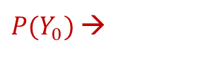
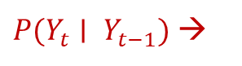
Markov Chain Inference - Example
Transition Matrix
Initial State
0.2 | 0.6 | 0.2
0.3 | 0 | 0.7
0.5 | 0 | 0.5
$P(Y_{t}∣ Y_{t−1})$ →
A =
p0 =
$P(Y_{0})$ →
0 | 1 | 0
Probabilities for First Drink (1)
0.2 | 0.6 | 0.2
0.3 | 0 | 0.7
0.5 | 0 | 0.5
p0 A =
p1 =
0 | 1 | 0
*
=
0.3 | 0 | 0.7
Probabilities for Second Drink (2)
0.2 | 0.6 | 0.2
0.3 | 0 | 0.7
0.5 | 0 | 0.5
p2 =
p1 A =
0.3 | 0 | 0.7
*
=
0.41 | 0.18 | 0.41
Probabilities for Third Drink (3)
0.2 | 0.6 | 0.2
0.3 | 0 | 0.7
0.5 | 0 | 0.5
p3 =
p2 A =
0.41 | 0.18 | 0.41
*
=
0.34 | 0.25 | 0.41
Probabilities for Fourth Drink (4)
0.2 | 0.6 | 0.2
0.3 | 0 | 0.7
0.5 | 0 | 0.5
p3 A =
p4 =
0.34 | 0.25 | 0.41
*
=
0.35 | 0.20 | 0.45
tea coffee water

Slide 29
Markov Chain – Prediction Types
Markov Chains reduce the complexity of the systems by Markov properties, still providing a reasonable approximation for many real-world problems:
Provide a powerful mathematical framework for modeling systems that evolve over time with probabilistic transitions
A Markov chain is a probabilistic version of a state machine can model a sequence of states applicable in robotics and RL
It supports two types of predictions:
Short-term behavior: Predicting the next states
Long-term behavior: Finding long-term state of the system.

Slide 30
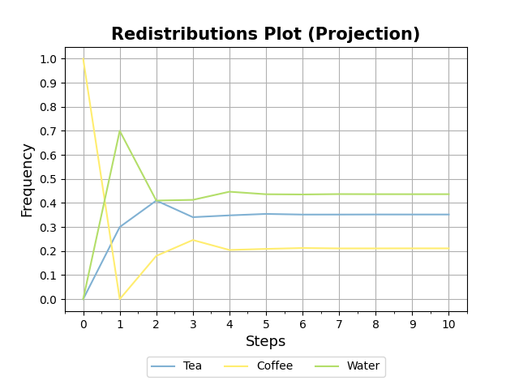
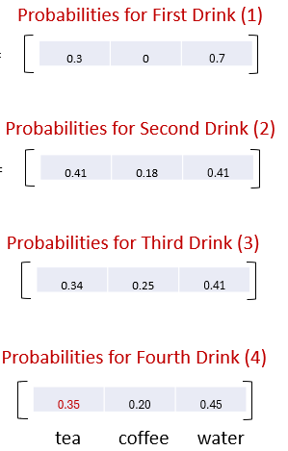
Stationary (Steady) State
Over time, the system forgets its initial state and converges to the stationary distribution
A stationary distribution of a Markov chain remains unchanged in the Markov chain as time progresses
The long-term probabilities of being in each state are given by the stationary distribution.
The stationary state doesn’t depend on the starting state.
What are the conditions for a Markov chain to converge to the steady state?

Slide 31
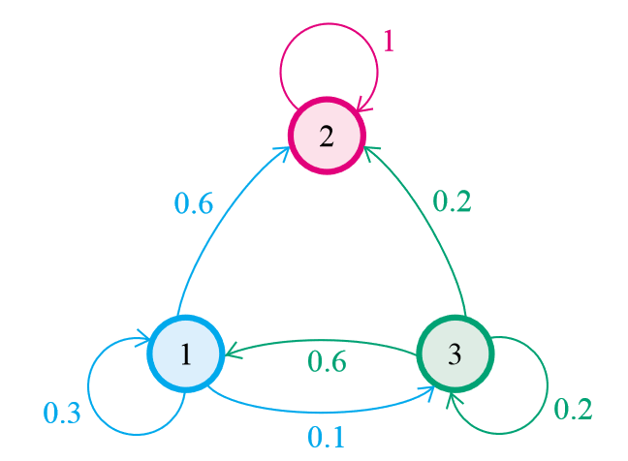
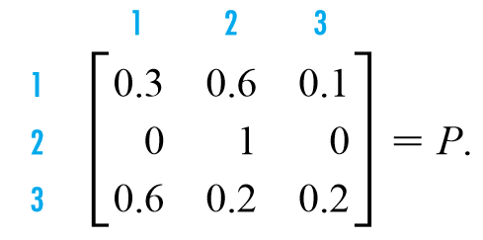
Absorbing Markov
A Markov chain does not converge a steady-state if it is absorbing
A state of a Markov chain is called an absorbing state if, once the Markov chains enters the state, it remains there forever.
A Markov chain is called an absorbing chain if:
It has at least one absorbing state.
For every state in the chain, the probability of reaching an absorbing state in a finite number of steps is nonzero.
State 2 is absorbing
P(2,2) = 1

Slide 32
Periodic Markov
A Markov chain is periodic if there exists a state with period 𝑑> 1, meaning that the system can only return to the state in fixed steps that are multiples of 𝑑.
This periodicity prevents probabilities from converging (steady) because the system keeps cycling through certain states in a repetitive manner.

Slide 33
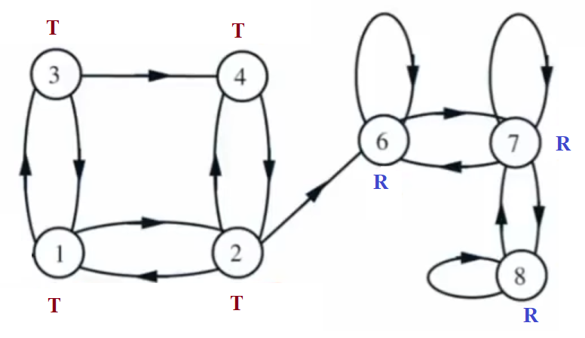
Recurrent and Transient States
A Markov chain does not converge a steady state for transient states
A state is recurrent if any possible path from the state, can eventually return to the state within finite time
Transient states are those that are not recurrent.

Slide 34
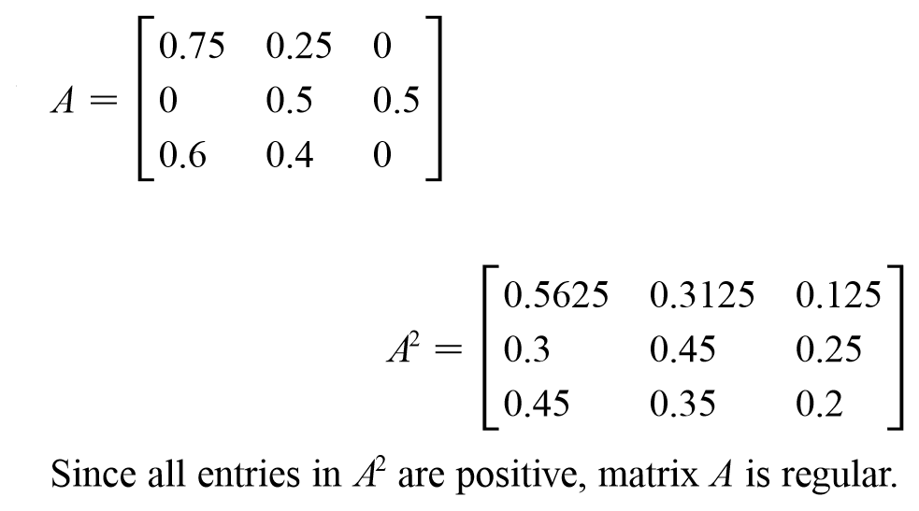
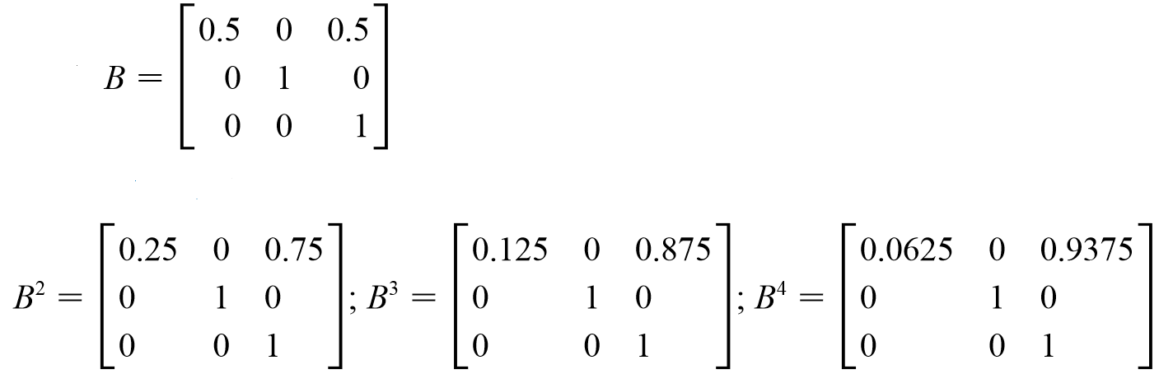
Regular Markov
A Markov chain may not reach a steady-state if the chain has an irregular transition matrix
A Markov chain is a regular Markov chain if some power of the transition matrix has only positive entries. So, it is possible to reach any state from any other state in a finite number of steps
Regular
Not regular

Slide 35
Markov Chain - Ergodicity
Any ergodic Markov chain converge to a stationary distribution. In this steady distribution, every state has a positive probability.
A Markov chain is ergodic if:
Irreducibility: for any two states i and j, it is possible to go from i to j with positive probability (in some number of steps). Absorbing and irregular transition matrices are not irreducible (there are some isolated groups of states).
Aperiodicity: the chain doesn’t get caught in cycles
Recurrent : the chain has no transient state.

Slide 36
Stationary(Steady) State - Calculation
Any ergodic Markov chain will eventually converge to a stationary distribution (assuming a finite state space).
Over the long run, a stationary distribution of a Markov chain remains unchanged in the Markov chain as time progresses
Under the assumption that it is possible to get from any state to any other state, then there will be a unique stationary distribution
This can be obtained by finding the eigenvector of the transition matrix:
π A = π (π A = λ π , λ = 1)
π [1] + π [2] + … + π [n] = 1
π is a vector of probabilities in the steady state
π (A- I) = 0
→ π [1] + π [2] + … + π [n] = 1

Slide 37
Stationary State - Example
π (A- I) = 0
π [1] + π [2] + π [3] = 1
0.2 | 0.6 | 0.2
0.3 | 0 | 0.7
0.5 | 0 | 0.5
1 | 0 | 0
0 | 1 | 0
0 | 0 | 1
0.2 – 1 | 0.6 | 0.2
0.3 | 0 – 1 | 0.7
0.5 | 0 | 05 - 1
-0.8 | 0.6 | 0.2
0.3 | -1 | 0.7
0.5 | 0 | -0.5
(A- I)
-
=
=
=
Stationary
State
-0.8 | 0.6 | 0.2
0.3 | -1 | 0.7
0.5 | 0 | -0.5
0
0
0
T * -0.8 + C * 0.3 + W * 0.5 = 0
T * 0.6 + C * -1 + W * 0 = 0
T * 0.2 + C * 0.7 + W * -0.5 = 0
T + C + W = 1
π (A- I) =
T= 0.35211 C=0.21127 W=0.43662
T C W
*
=
π =
0.35211 0.21127 0.43662
0.2 | 0.6 | 0.2
0.3 | 0 | 0.7
0.5 | 0 | 0.5
0.35211 0.21127 0.43662
*
=
0.35211 0.21127 0.43662

Slide 38
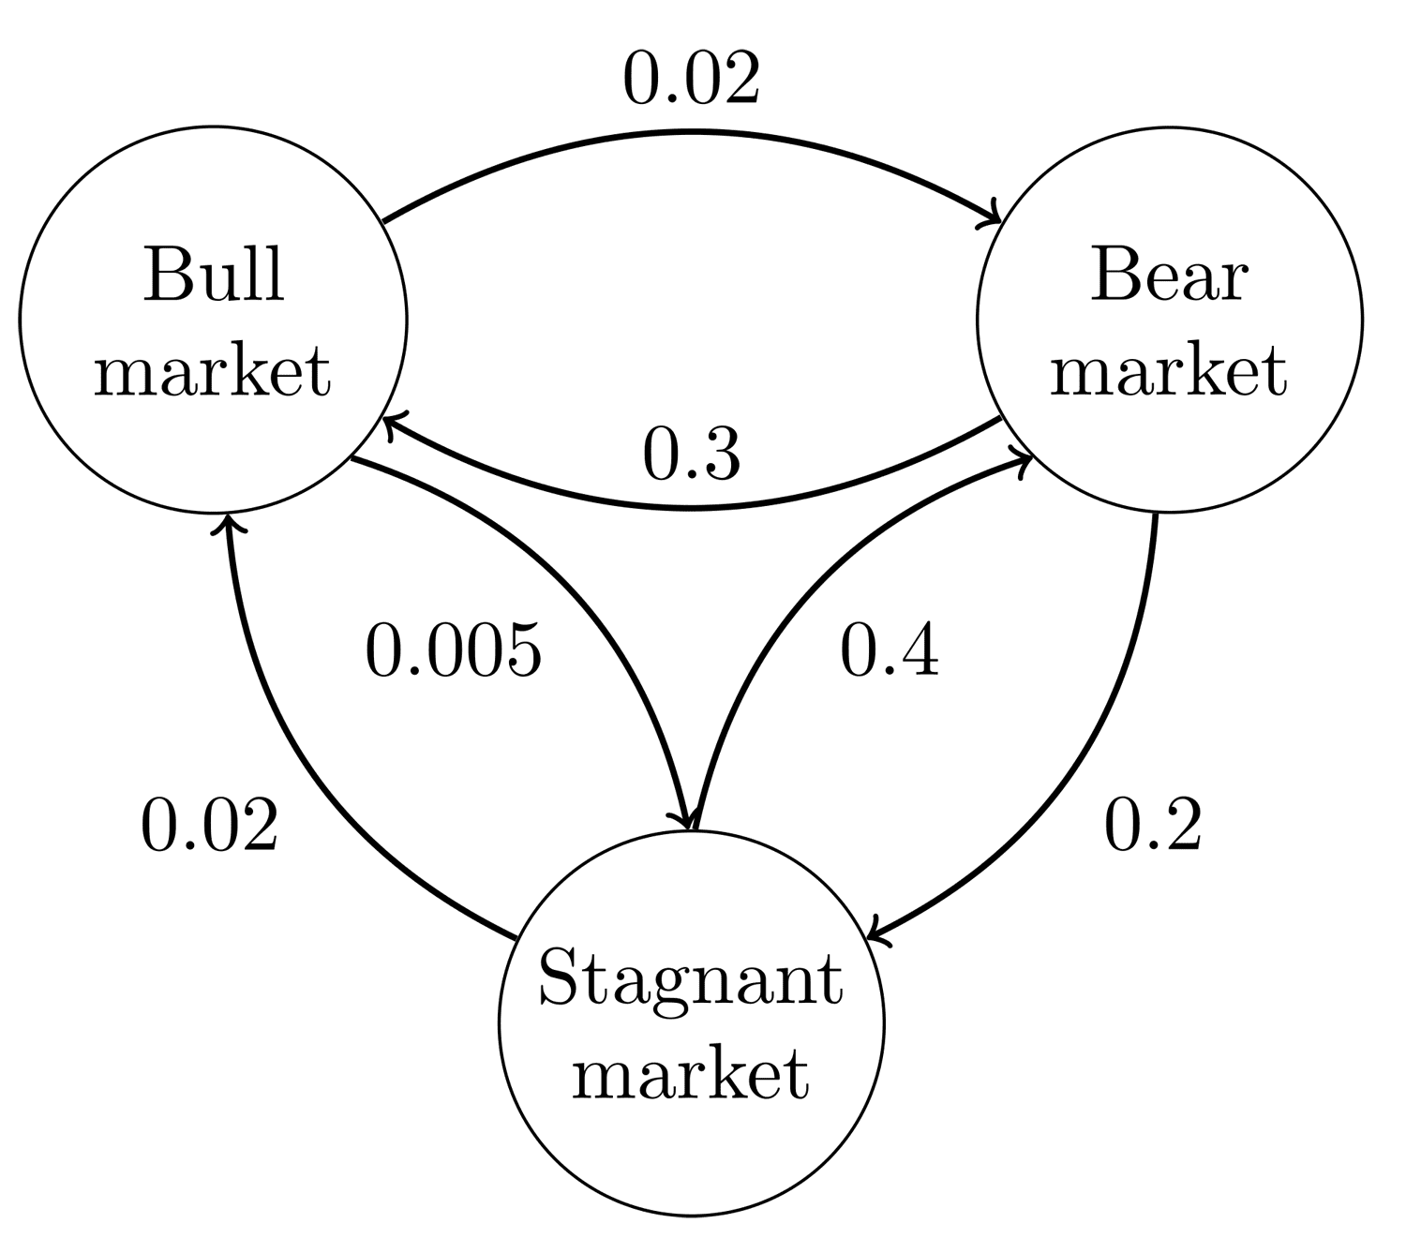
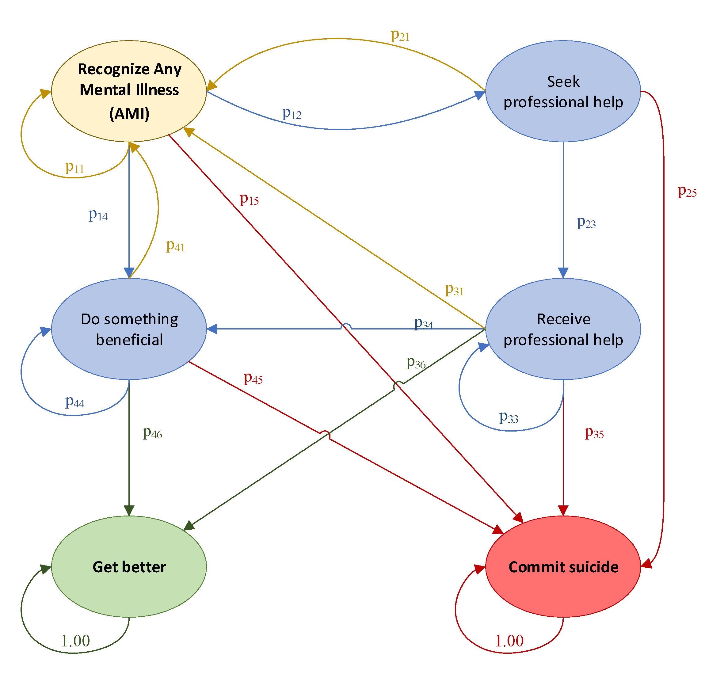
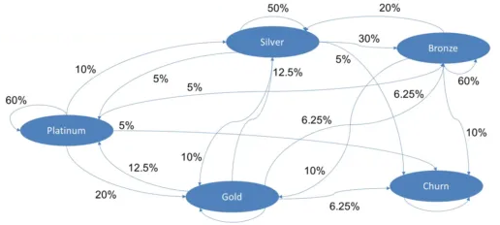
Stationary State Applications
Steady State is widely used in analyzing the long-term behavior of systems. it converts random short-term transitions into stable insights:
Queueing Systems: to forecast the long-run waiting time in different states.
Risk Assessment: To forecast long-term risk based on short term probabilities
Revenue: to forecast the long-term expected revenue from different sources
Scenario analysis: Changing transition probabilities to model long-term state
Reinforcement learning (RL): To estimate long-term rewards.

Slide 39
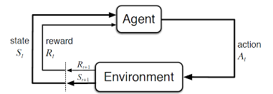
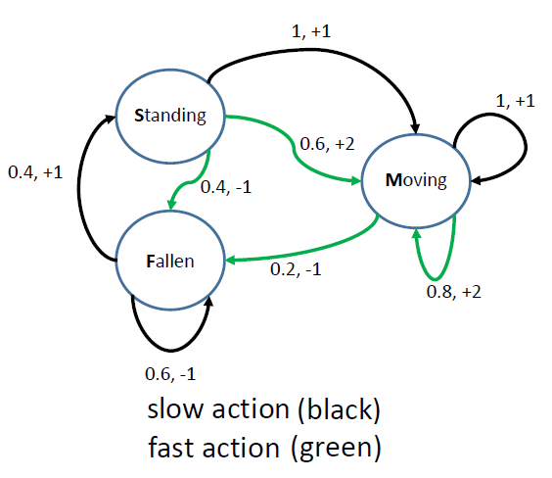
Markov-Decision Process in RL
Markov Decision Proce (MDP):
MDPs are the Markov chains with rewards as values.
Rewards are the numerical values that the agent receives on performing some action at some state(s)
Agent needs to learn a policy to chose the action for each state that gets best reward
The agent uses the Markov model to find the action with highest cumulative reward (long-term reward) for each state

Slide 40
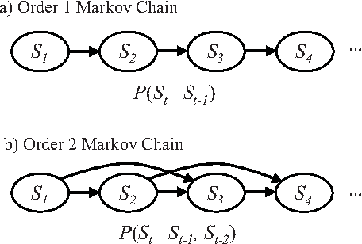
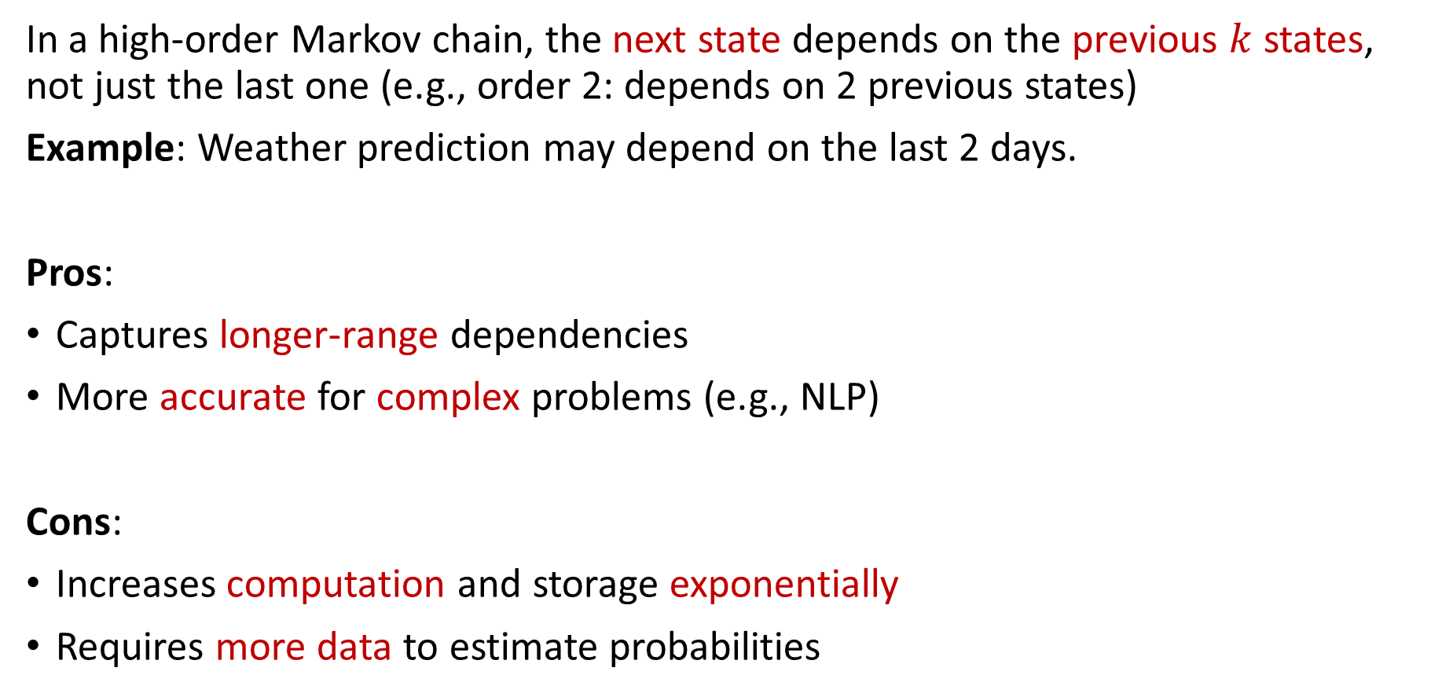
Higher Order Markov Chain
In a high-order Markov chain, the next state depends on the previous $k$ states, not just the last one (e.g., order 2: depends on 2 previous states)
Example: Weather prediction may depend on the last 2 days.
Pros:
Captures longer-range dependencies
More accurate for complex problems (e.g., NLP)
Cons:
Increases computation and storage exponentially
Requires more data to estimate probabilities

Slide 41
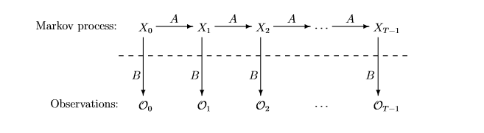
Hidden Markov Model
A hidden Markov model (HMM) is a Markov chain with unobserved (hidden) states.
In HMM, the state is not directly visible, but output dependent on the state (observation) is visible.
In addition to the transition matrix, there is also an observation matrix (Emission Matrix).
The observation matrix calculates the probability of the possible observations from a state.
We don’t know the state sequence. However, we know probabilistic function of it (Transition Matrix).
The parameters of model can be estimated using prior knowledge or the Baum-Welch algorithm

Slide 42
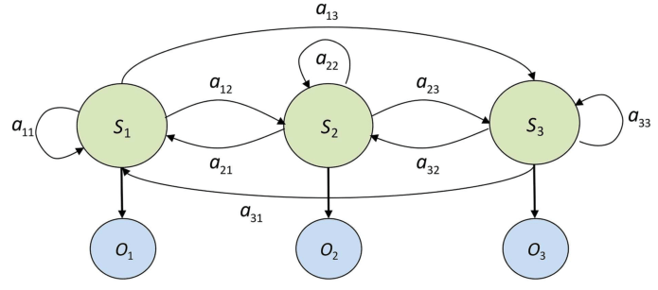
HMM - Problem Statement
Evaluation problem: Given an observation sequence and a model (π, A, B), calculate the probability of the observations.
Decoding problem : Given an observation sequence and a model (π, A, B), calculate the most probable state sequence

Slide 43
Hidden Markov Model - Evaluation problem
For a given HMM, the probability of an observed sequence O₁O₂O₃ … O_{T} is obtained by summing over all possible state sequences.
0.5
0.5
Low (x0)
High (x1)
0.3
0.7
0.8
0.6
0.4
0.2
Rain (y0)
Dry (y1)
Two hidden states : ‘Low’ and ‘High’ atmospheric pressure.
Two observations : ‘Rain’ and ‘Dry’.

Slide 44
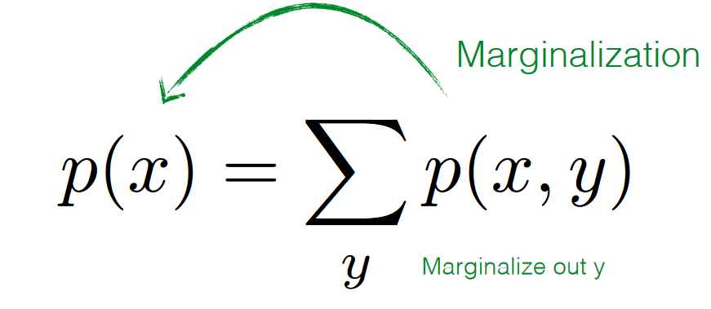
Marginalization
Marginalization: Remove a variable by summing over all its possible states
The initial state distribution :
P(Low Pressure)=0.375
P(High Pressure)=0.625
From emission matrix:
p(Rain | High Pressure) = 0.4
p(Rain | Low Pressure) = 0.8
Marginalize out atmospheric pressure:
P(Rain) = P(Rain, Low Pressure) + P(Rain, High Pressure)
= p(Rain | Low Pressure) * p(Low Pressure) + p(Rain | High Pressure) * p(High Pressure)
= 0.8 * 0.375 + 0.4* 0.625
= 0.55

Slide 45
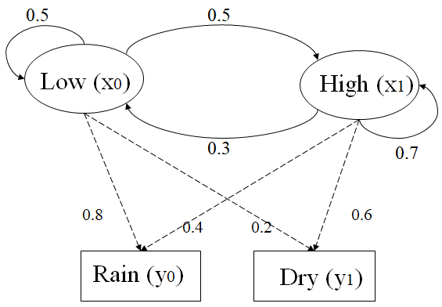
Evaluation Problem - Example
Suppose we want to calculate a probability of a sequence of observations: {‘Dry’,’Rain’}.
Suppose initial state probabilities: P(‘Low’)=0.375 , P(‘High’)=0.625
Consider all possible hidden state sequences:
P({‘Dry’,’Rain’} ) = P({‘Dry’,’Rain’} , {‘Low’,’Low’}) + P({‘Dry’,’Rain’} , {‘Low’,’High’}) + P({‘Dry’,’Rain’} , {‘High’,’Low’}) + P({‘Dry’,’Rain’} , {‘High’,’High’})
Where first term is :
P({‘Dry’,’Rain’} , {‘Low’,’Low’})=
P({‘Dry’,’Rain’} | {‘Low’,’Low’}) P({‘Low’,’Low’}) =
P(‘Dry’|’Low’)P(‘Rain’|’Low’) P(‘Low’|’Low) P(‘Low’)
= 0.2*0.8*0.5*0.375
= 0.03
Many redundant calculations - Computationally expensive

Slide 46
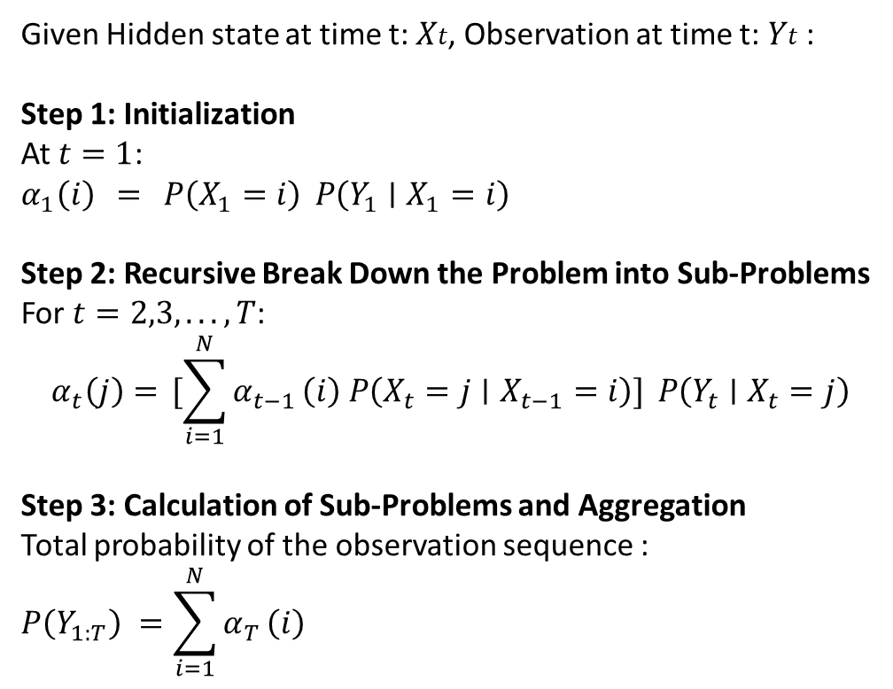
Evaluation Problem - Forward Algorithm
Forward Algorithm:
Uses dynamic programming and recursion
Keeps previous subproblem solution to speed up calculations
Uses Markov assumption that each state is only influenced by the last state
Uses marginalization
Given Hidden state at time t: 𝑋𝑡, Observation at time t: 𝑌𝑡​ :
Step 1: Initialization
At $t=1$:
$$α_{1}\left(i\right) = P\left(X_{1}=i\right) P\left(Y_{1}∣X_{1}=i\right)$$
Step 2: Recursive Break Down the Problem into Sub-Problems
For $t=2,3,...,T$:
$$α_{t}\left(j\right)= [\sum_{i=1}^{N}{α_{t−1}}\left(i\right) P\left(X_{t}=j∣X_{t−1}=i\right)] P\left(Y_{t}∣X_{t}=j\right)$$
Step 3: Calculation of Sub-Problems and Aggregation
Total probability of the observation sequence :
$$P\left(Y_{1:T}\right) =\sum_{i=1}^{N}{α_{T}}\left(i\right)$$

Slide 47
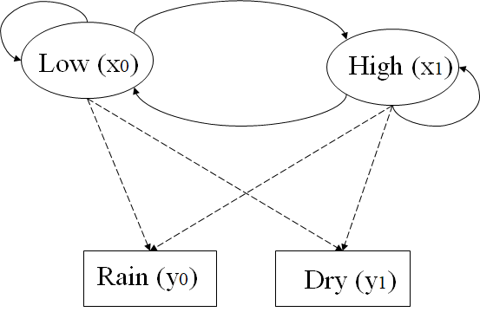
Evaluation problem - Example
Suppose we want to calculate a probability of a sequence of observations in our example, {’Rain’, ’Rain’, ‘Dry’}.
Suppose initial probabilities: P(‘Low’)=0.375 , P(‘High’)=0.625
Observations: Y0 = ‘Rain’ , Y1=’Dry’
Hidden States: X0 = ‘Low’ , X1=‘High’
Using Forward algorithm calculate :
P (y0,y0,y1) = P({’Rain’, ’Rain’, ‘Dry’} )

Slide 48
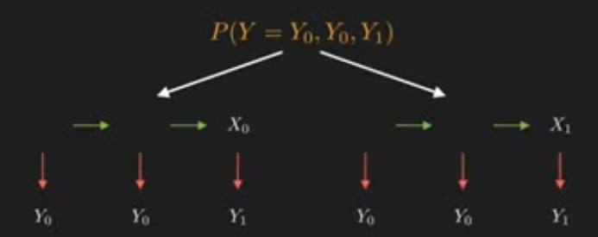
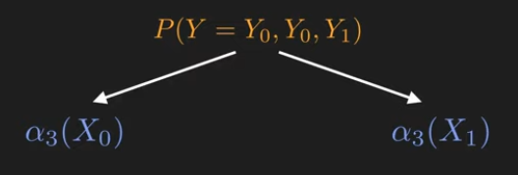
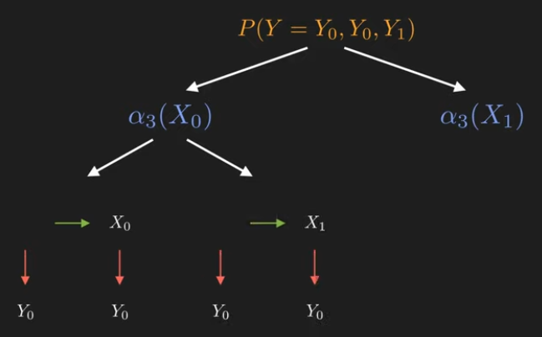

Forward Algorithm - Example
Marginalization
Markov Property: current state only depends on last state
3rd observation is Y1 → α3(X0) = p(Y1|X0) * (α2(X0)*p(X0|X0) + α2(X1)*p(X0|X1))
3rd observation is Y1 → α3(X1) = p(Y1|X1) * (α2(X0)*p(X1|X0) + α2(X1)*p(X1|X1))
Observation Matrix Transition Matrix

Slide 49



Forward Algorithm - Example

Slide 50
Decoding Problem
Viterbi is another dynamic programming algorithm used to find the most likely sequence of hidden states (Viterbi path) in an HMM, given a sequence of observed events.
Example:
Observations: [Dry, Dry, Rain]
Viterbi path (most Probable Sequence of Hidden States):
[High, High, High]
Initial probabilities: P(Low)=0.4 , P(High)=0.6

Slide 51

Applications of HMM
The Dual Nature of States: The hidden states are typically causes of observable states. This is applicable in many domains:
Unknown disease of observed symptoms
Hidden factors of observed consumer behavior
Hidden market conditions by observed prices
Unknown structure of observed sentence

Slide 52
Application of HMM, Part-of-Speech (POS) Tagging
Given a sentence (sequence of words), it is possible to calculate the most probable hidden state sequence (syntactic roles of words) using a Hidden Markov model (decoding problem)
Transitions
Emissions (Observation Matrix)
P(The | Determiner) = 0.5
P(A | Determiner) = 0.3
P(An | Determiner) = 0.1
P(Fed | Determiner) = 0
…
P(Fed| Noun) = 0.01
P(raises| Noun) = 0.04
P(interest| Noun) = 0.07
P(The| Noun) = 0
…
Determiner
Noun
Verb
The Fed raises interest rates
start
Determiner
Noun
Verb
Noun
Noun
Initial
The
Fed
raises
interest
rates

Slide 53

Confirmatory Data Analysis (CDA)
In data analysis, when a pattern, difference or relationship is recognized, it is essential to identify that it is reliable (significant) or just a result of random chance
CDA is a statistical method based on probabilistic principles to test whether the effects/differences are statistically significant. It has several components:
Null Hypothesis (H0): Assumes no significant effect or difference
Alternative Hypothesis (Ha): There is a significant effect or a difference
Significance Level (α): The threshold for rejecting H0
P-value: The probability of observing the data, assuming H0 is true
In scientific research CDA plays a crucial role in ensuring scientific rigor

Slide 54



Significant Difference (Effect) Tests
One-Sample Test: Compares a single sample to a known or hypothesized population to see if they are significantly different.
Example: Testing if the average rate of cancer among smokers (a sample) is significantly different from the rate of cancer in general population.
Two-Sample Test (Independent Test): Compares two independent groups to see if they are significantly different.
Example: Testing if there is a significant difference in the average rate of cancer between smokers (a sample) and non-smokers (another sample).
Paired Test (Dependent Test): Compares two related groups (paired data) to see if they are significantly different.
Example: Testing if there is a significant difference in the average size of tumor in patients before using a drug (a sample) and after using the drug (the same people)

Slide 55

Identify Significant Difference - Method
Problem: How to recognize whether two population are similar or different?
Solution:
1- Take a sample from each population (assume they represent the characteristics of their population)
2- Calculate mean values of each sample
3- Compare these mean values
Problem: How to recognize whether the difference between means is statistically significant or not?

Slide 56

Central Limit Theorem (CLT)
The CLT states that the distribution of sample means approximately is a normal distribution if the samples sizes are large (> 30), regardless of the original population distribution.
Considering large samples from two same (or similar) population, the difference between the means also follows a normal distribution
Symmetrical and bell-shaped distribution centered around mean value
Probability of falling within a range can be derived from normal distribution

Slide 57

Statistically Significant Difference
The difference between the means of large samples from two similar population follows a normal distribution
There is around 95% of chance that this difference would be within a range between (mean – 1.96*Sd) and (mean + 1.96*Sd), if the two population are similar → it is very unlikely (5%) to be outside of this range
If the difference is outside of the range, it indicates that there is a statistically significant difference between populations since it is very unlikely to happen by random chance

Slide 58


Standard Normal Distribution
If we normalize a variable follows a normal distribution with Z-score in the resulting distribution:
Mean (μ) = 0
Standard Deviation (σ) = 1
This distribution is called Standard Normal Distribution which is a special case of the normal distribution .
1,2 -> (mean - 1.96*Sd) = -1.96 , (mean + 1.96*Sd) = 1.96
Normalize data

Slide 59

Z-test
Z-score (z-value) of differences between the means of two samples or between a sample and a population is calculated
If Z-Score > 1.96 or Z-Score < -1.96 then with 95% confidence the difference is statistically significant and not due to random chance (significance level (𝛼)=0.05)
1.96 is the threshold (critical value) for 𝛼 = 0.05 but there are also different thresholds level For various significance levels (e.g., 0.01 or 0.1)
Significance Level (α) | Critical Value
0.10 | ±1.645
0.05 | ±1.96
0.02 | ±2.326
0.01 | ±2.576
0.001 | ±3.291

Slide 60

T-test
Problem: When the sample size is small, the mean and SD values are less reliable estimates of the true values of population (z-score is not precise)
Solution: When the sample size is small, a t-score (t-distribution) is used instead of z-score to adjust for the extra uncertainty in estimating parameters of population
When to Use a T-Test:
The sample size is relatively small (n<30).
The data is approximately normally distributed (t-distribution table is based on assumption of normal distribution)
The variable is continuous
df = number of samples - 1
T-test is more conservative (bigger tail in distribution) than the Z-distribution for smaller samples

Slide 61


T-Distribution table
There are different t-distributions based on the number of samples
T-distribution table shows critical values (thresholds) for different number of samples and significance levels
These critical values are presented for some significance levels based on sample size (df = sample size - 1)

Slide 62



T-Test Steps
Formulate Hypotheses (H0 and Ha)
Based on the hypotheses chose one test type(One-Sample, Two-Sample, Paired)
Set the significance level based on the requirement of the study
Calculate the t-value (t-score) using the formula for the test type:
One-Sample Two-Sample Paired
Find the critical value in t-distribution table based on df and 𝛼
If a t-value is bigger than the critical value under a significance level it means the difference is statistically significant (reject null hypothesis), otherwise there is no statistically significant difference

Slide 63
T-test - Example
We want to test whether a method of hyperparameter tuning is effective in accuracy of models.
The accuracies of 10 models are measured before and after hyperparameter tuning.
Null Hypothesis (𝐻0): The tuning has no significant effect on accuracy
Alternative Hypothesis (𝐻𝑎): The tuning makes significant difference
Significance level (𝛼) = 0.05
The samples are related → paired t-test
Model | Before Tuning | After Tuning
1 | 40 | 45
2 | 38 | 42
3 | 36 | 41
4 | 39 | 43
5 | 35 | 40
6 | 37 | 42
7 | 34 | 39
8 | 36 | 40
9 | 38 | 43
10 | 39 | 44

Slide 64

Paired T-test
Calculate the difference between before and after tuning for each model:
Model | Before Tuning | After Tuning
1 | 40 | 45
2 | 38 | 42
3 | 36 | 41
4 | 39 | 43
5 | 35 | 40
6 | 37 | 42
7 | 34 | 39
8 | 36 | 40
9 | 38 | 43
10 | 39 | 44
Model | Difference (d) = After - Before
1 | 5
2 | 4
3 | 5
4 | 4
5 | 5
6 | 5
7 | 5
8 | 4
9 | 5
10 | 5
Mean of differences :
(Differences of Means)
Sd of differences :
= (5−4.8)^2 + (4−4.8) ^2 + ⋯ / (10-1) → Sd= 0.42

Slide 65


Calculate T-Value (T-Score)
T-Value Formula for Paired T-Test:
Degree of Freedom (df) = n -1 = 9
The critical value(α=0.05,df=9) =2.262
T-value (36.09) > critical value (2.262)
t-distribution table

Slide 66

Analysis of Result
Since t-value > critical value, we reject the null hypothesis.(P-value would be less than 5%)
This means the result is statistically significant at the α=0.05
Conclusion:
The tuning method had a significant impact on accuracy of models.
On average, accuracy increased by 4.8%, and the result is statistically significant at the α=0.05 significance level.

Slide 67

Significance Level - Trade-off
Type 1 Error (False Positive): Rejecting the null hypothesis (H0​) when it is actually true
Example: A drug is declared effective when it actually makes no difference (when α is 5% means a 5% chance of making this error)
Type 2 Error (False Negative): Failing to reject the null hypothesis (H0​) when it is actually false.
Example: A drug is declared ineffective when it actually makes difference.
Increasing α : Reduces False Negative (more sensitive) but increases the risk of False Positive .
Lowering α : Reduces False Positive (more specific) but increases the risk of False Negative.
The balance depends on the context :
α of 5% is default in most research fields
α of 1% is used in high-stakes decisions (medical decisions)
α of 10% can be used in exploratory studies

Slide 68

Other Types of Tests
There are many other tests on different aspects (e.g., variance), different type of data (e.g., categorical), and different distributions (e.g., not normal):
F-test: Compare variances of two population
ANOVA: Compare three or more groups.
Non-parametric tests (e.g., Wilcoxon tests): For data that doesn't meet normality assumptions.
Chi-square test: For categorical data, compare observed vs expected frequencies
…

Slide 69

Assignment 7
Using Naïve Bayes on amr_ds.csv dataset (use 75% for training and 25% for test), predict not_MDR column by two other columns. Calculate accuracy of the model on the test data.
Using all records in amr_ds.csv dataset to calculate following formula manually or using a piece of code:
amp_pen = number of records with Ampicillin=1 and Penicillin =1
amp_nmdr = number of records with Ampicillin=1 and Not_MDR =1
pen_ nmdr = number of records with Penicillin =1 and Not_MDR =1
Using states [‘Ampicillin’,’ Penicillin’,’ Not_MDR’] and following transition matrix develop a code to create a Markov chain.
transition_matrix = [[0, amp_pen/(amp_nmdr+amp_pen), amp_nmdr/(amp_nmdr+amp_pen)],
[amp_pen/(pen_nmdr+amp_pen), 0, pen_nmdr/(pen_nmdr+amp_pen)],
[amp_nmdr/(amp_nmdr+pen_nmdr), pen_nmdr/(amp_nmdr+pen_nmdr), 0]]
Calculate the probability of each state in long term (stationary state).
Suppose that there is an association between infection after surgery and resistances to antimicrobials as follows:
Predict most probable sequence of states if we observe the following sequence in a patient:
[Infection after surgery, No infection after surgery, Infection after surgery]
 | No Infection | Infection
Amp | 0.4 | 0.6
Pen | 0.3 | 0.7
NMDR | 0.8 | 0.2

